Slide 1
Mastering the Whiteboard
Zoiner Tejada

Slide 2
Abstract and learning objectives
Abstract This session reviews concepts and tools that help in whiteboarding so you can make the most of your toolkit and devices. Co-creation of an evaluation rubric helps tie together ways of appraising mastery and identifying areas for improvement.
Learning Objectives
Identify a range of whiteboarding modalities and know when best to use each one.
Add useful elements and tools to their whiteboarding techniques.

Slide 3

Overview
Start with a proven practice whiteboard layout.
Use standard icons from the Microsoft Cloud & Enterprise symbol set.
Memorize your frequently used icons so you can sketch them quickly and be consistent.
Use the design to confirm your understanding with the customer.
Refine the whiteboard “sketch” in Visio or PowerPoint.
Notes:
During the ADS, you and your customer planned a high-level architecture and conceptual design for a solution that addresses their organization’s business goals and technical requirements.

Slide 4
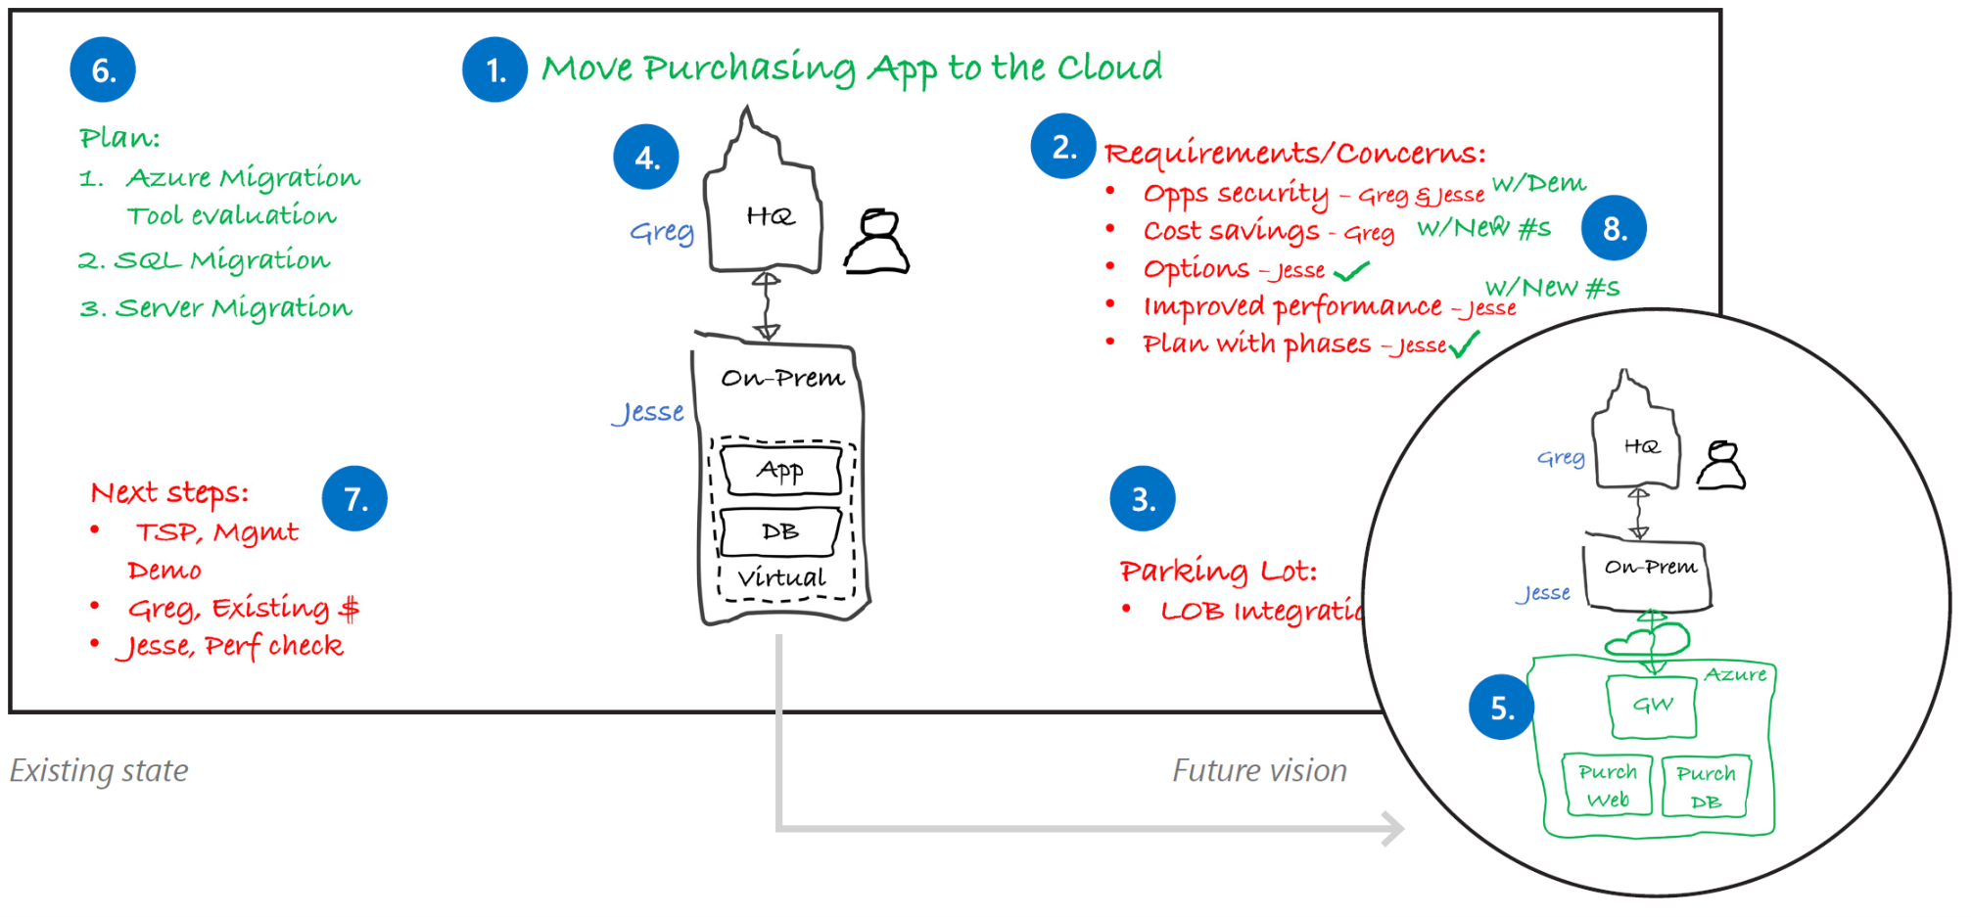
Proven practice whiteboard layout
Project Goal
Requirements & concerns
Parking lot
Current State
Future Vision
Implementation plan
Next steps
Wrap-up
Notes:
1. Project goal
Write down the project goal to help focus everyone to the desired outcomes.
2. Requirements and concerns
Begin with the items you’ve listed from the pre-call. Make sure that everyone gets a chance to be heard. Write down names next to each person’s requirements or concerns.
3. Parking lot
Acknowledge out-of-scope items. Help people set these concerns aside for later and focus back on the topic at hand.
4. Current state
Diagram the current state and ownership in black. The customer may help diagram this on the whiteboard. Be careful with technical depth. Focus on the system details that affect the ADS outcomes.
5. Future vision
Capture a high-level view of what the customer really wants in green before diving into technologies. Help customers envision the potential opportunities with Microsoft technologies.
6. Implementation plan
Break the plan into clear steps so the customer can track the project schedule and budget flexibility.
7. Next steps
Assign immediate action items during the meeting.
8. Wrap-up
Verify with all stakeholders that their requirements and concerns have been sufficiently addressed with the solution and plan. Close with agreement on the next steps.

Slide 5
Take advantage of your canvas
Dry-erase whiteboard Aspect ratio (wide or tall)? Multiple colors of markers?
Flipchart
Can you peel and stick completed pages on a wall?
Digital whiteboards like Surface Hub
Are you comfortable with basic functions to draw, erase, change pen color and capture screen shots?
Laptop over a projection or Teams/Skype call
Do you have a starter set of shapes and symbols you can quickly assemble in front of an audience? Can you draw with the digital pen?

Slide 6
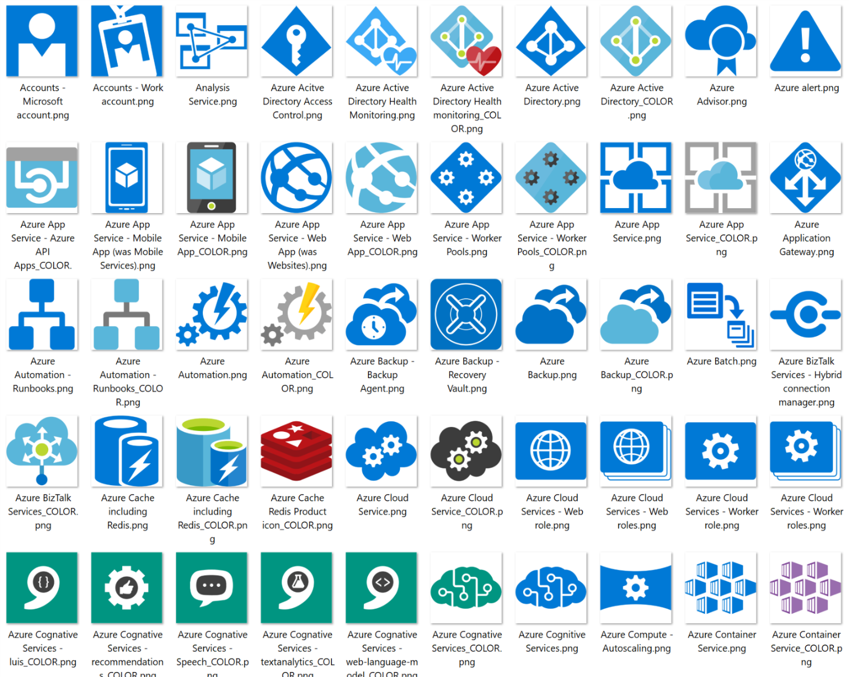
Use standard icons for Azure services
All icons available under the Symbols\CNE_Cloud folder.
Files types in package
Visio Stencil (.vss)
PNG file
SVG file
Download the Microsoft Azure, Cloud and Enterprise Symbol/Icon Set
https://www.microsoft.com/en-us/download/details.aspx?id=41937
Notes:
Microsoft has made available icon libraries for PowerPoint (as PNG files) and Visio that simplify creating great diagrams using standardized icons for Azure services.

Slide 7
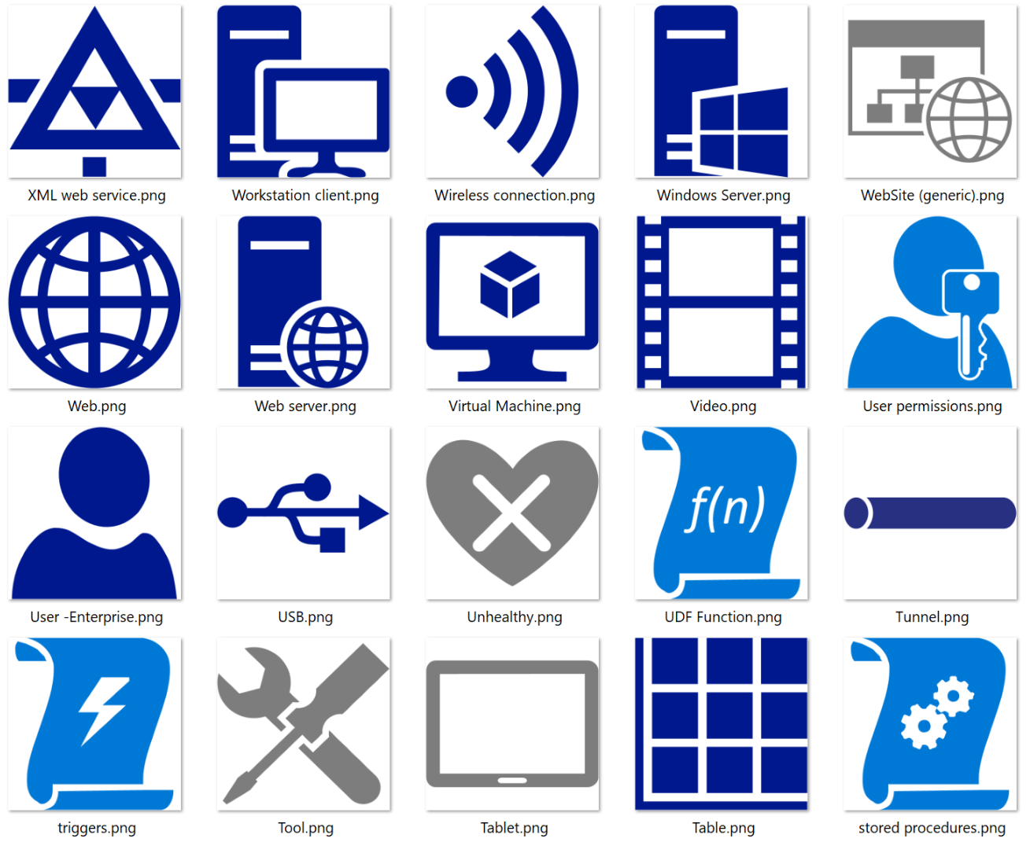
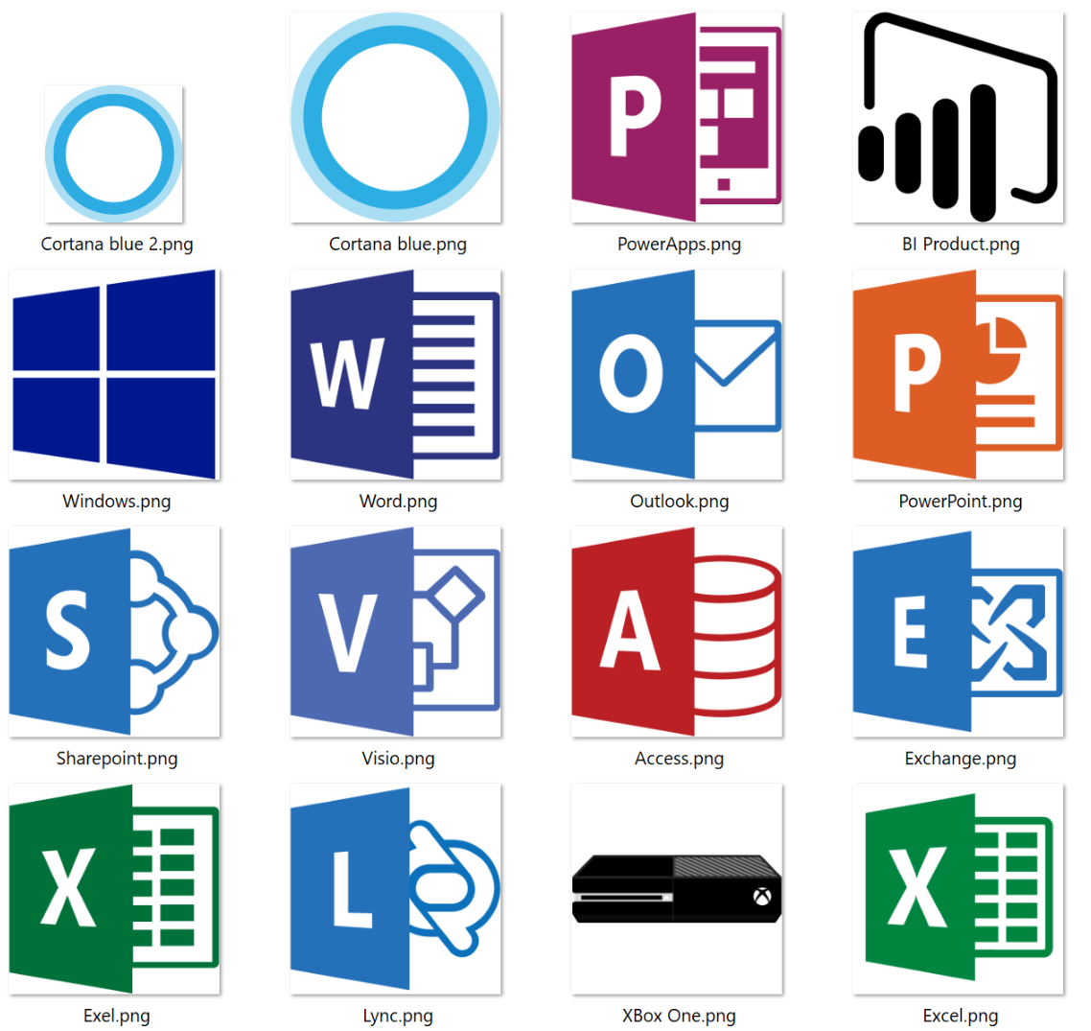
Other icons in the Symbols set
Enterprise symbols
Under the Symbols\CnE_Enterprise folder
Other Microsoft products
Under the Symbols\CnE_OtherMicrosoftProd folder

Slide 8
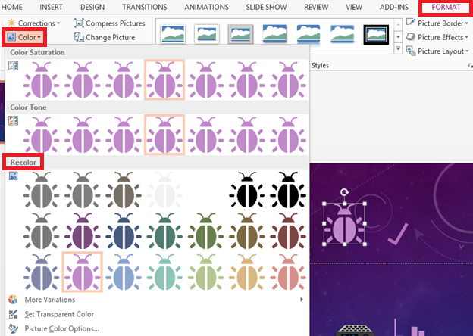
Pro-Tips for the Microsoft Azure, Cloud and Enterprise Symbol/Icon Set
Recolor shapes and PNG icons
Adjust the color of the icon easily using the Format, Color feature in PowerPoint
PowerPoint supports SVG via drag & drop
Enables creating larger icons that look crisp on the big screen
Convert SVG to Microsoft Office shape, ungroup and you can re-color the icon
Both PNG and SVG icons provide a transparent background

Slide 9






Want the icons from the Azure Portal?
Look under the Bonus\AzurePortalIconsDump folder

Slide 10
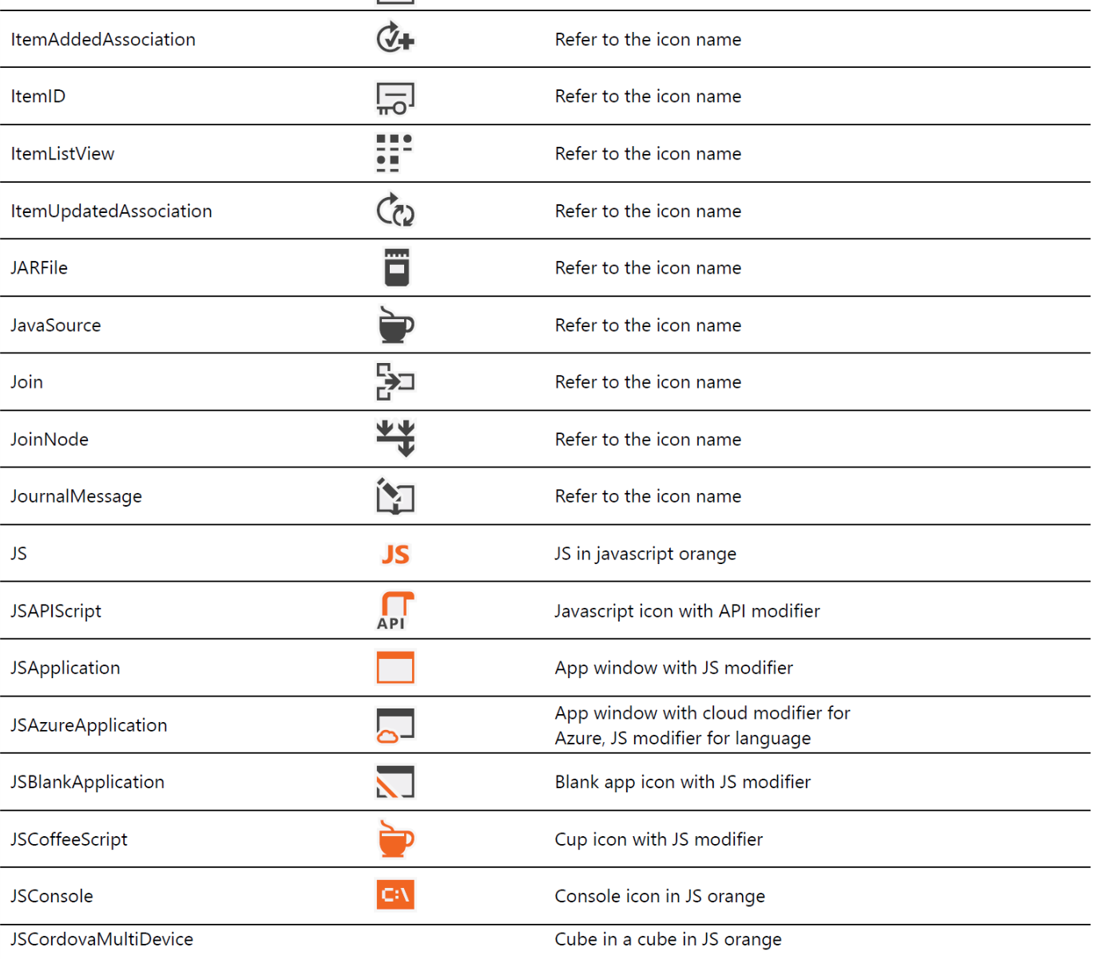

Visual Studio icons
Icons used within the Visual Studio user interface
Formats:
PNG
SVG
XAML
https://www.microsoft.com/en-us/download/details.aspx?id=35825

Slide 11
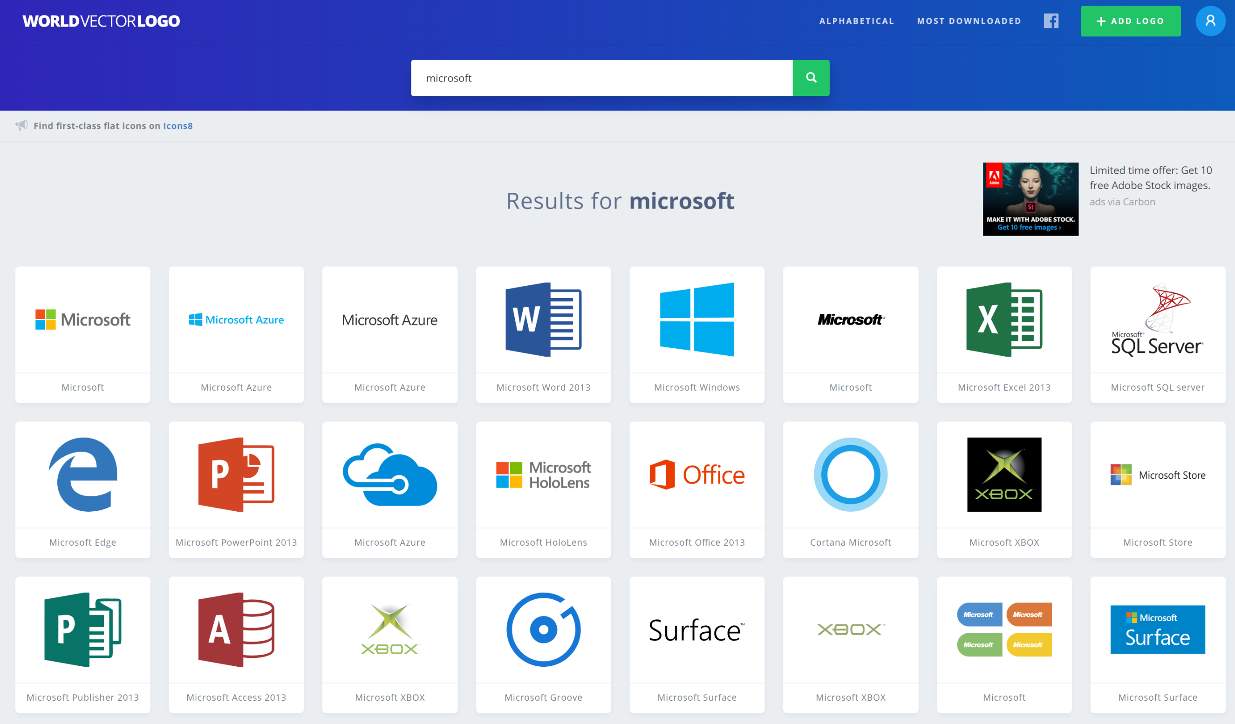
Icons and logos from other companies
NOTE: You are responsible for knowing the copyright and redistribution rules for these resources.
https://worldvectorlogo.com/

Slide 12
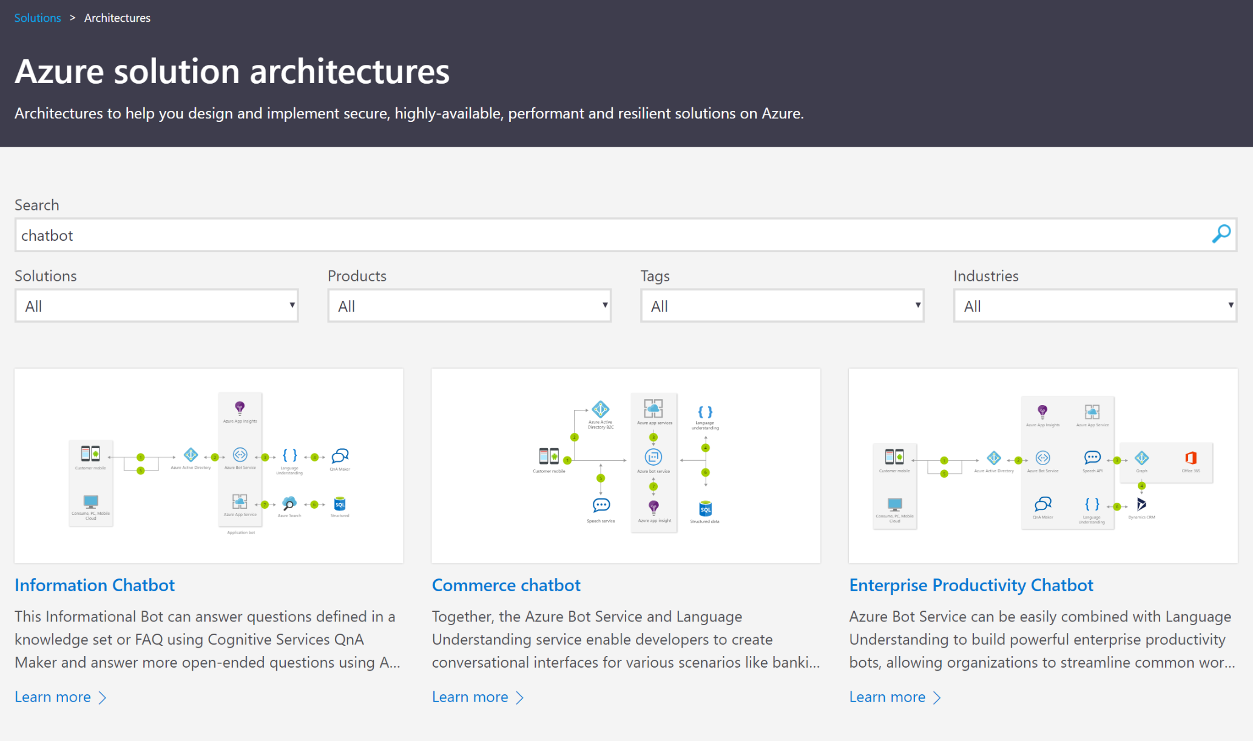
Need some inspiration?
Want a sample solution architecture diagram you can use to inspire your diagramming?
Start with one of the many solution architectures available from the Azure Solution Architectures site.
https://azure.microsoft.com/en-us/solutions/architecture/

Slide 13

What makes a good whiteboard design?

